Slide 1

Fundamentals of Software Engineering
Lecture 08: Writing Requirements

Slide 2
How to write GOOD REQUIREMENTS

Slide 3
Constraints of a Good requirement
• Unambiguous
• Testable (verifiable)
• Clear (concise, terse, simple, precise)
• Correct
• Understandable
• Feasible (realistic, possible)
• Independent
• Atomic
• Necessary
• Implementation free (abstract)

Slide 4
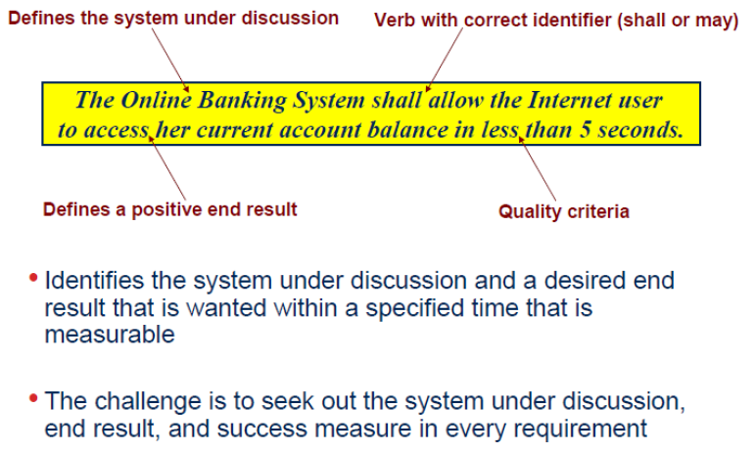
Writing a good requirement

Slide 5
Unambiguous
•There should be only one way to interpret the requirement. Sometimes ambiguity is introduced by undefined acronyms:
•REQ1The system shall be implemented using ASP.
•Does ASP mean Active Server Pages or Application Service Provider? To fix this, we can mention a full name and provide an acronym in parentheses:
•REQ1The system shall be implemented using Active Server Pages (ASP).
•Here’s another example:
•REQ1The system shall not accept passwords longer than 15 characters.
•It is not clear what the system is supposed to do:
•The system shall not let the user enter more than 15 characters.
•The system shall truncate the entered string to 15 characters.
•The system shall display an error message if the user enters more than 15 characters.

Slide 6
Testable (Verifiable)
•The system shall resist concurrent usage by many users.
•What number should be considered “many”—10, 100, 1,000?
•Some words can make a requirement untestable
•Some adjectives: robust, safe, accurate, effective, efficient, expandable, flexible, maintainable, reliable, user-friendly, adequate
•Some adverbs and adverbial phrases: quickly, safely, in a timely manner
•Nonspecific words or acronyms: etc., and/or, TBD

Slide 7
Clear (Concise, Terse, Simple, Precise)
•Requirements should not contain unnecessary verbiage or information. They should be stated clearly and simply:
•REQ1Sometimes the user will enter Airport Code, which the system will understand, but sometimes the closest city may replace it, so the user does not need to know what the airport code is, and it will still be understood by the system.
•This sentence may be replaced by a simpler one:
•REQ1The system shall identify the airport based on either an Airport Code or a City Name.

Slide 8
Correct
•If a requirement contains facts, these facts should be true:
•REQ1Car rental prices shall show all applicable taxes (including 6% state tax).
•The tax depends on the state, so the provided 6% figure is incorrect.

Slide 9
Understandable
•Requirements should be grammatically correct and written in a consistent style. Standard conventions should be used. The word “shall” should be used instead of “will,” “must,” or “may.”

Slide 10
Feasible (Realistic, Possible)
•The requirement should be doable within existing constraints such as time, money, and available resources:
•REQ1The system shall have a natural language interface that will understand commands given in English language.
•This requirement may be not feasible within a short span of development time.

Slide 11
Independent
•To understand the requirement, there should not be a need to know any other requirement:
•REQ1The list of available flights shall include flight numbers, departure time, and arrival time for every leg of a flight.
•REQ2It should be sorted by price.
•The word “It” in the second sentence refers to the previous requirement. However, if the order of the requirements changes, this requirement will not be understandable.

Slide 12
Atomic
•The requirement should contain a single traceable element:
•REQ1The system shall provide the opportunity to book the flight, purchase a ticket, reserve a hotel room, reserve a car, and provide information about attractions.
•This requirement combines five atomic requirements, which makes traceability very difficult. Sentences including the words “and” or “but” should be reviewed to see if they can be broken into atomic requirements.

Slide 13
Necessary
•A requirement is unnecessary if None of the stakeholders needs the requirement. Or Removing the requirement will not affect the system.
•An example of a requirement that is not needed by a stakeholder is a requirement that is added by developers and designers
•For example, the fact that a developer thinks that users would like a feature that displays a map of the airport and he knows how to implement it is not a valid reason to add this requirement.
•An example of a requirement that can be removed because it does not provide any new information might look like the following:
•REQ1All requirements specified in the Vision document shall be implemented and tested.

Slide 14
Implementation free (Abstract)
•Requirements should not contain unnecessary design and implementation information:
•REQ1Content information shall be stored in a text file.
•How the information is stored is transparent to the user and should be the designer’s or architect’s decision.
Notes:
If the requirement says text file, developers cannot use:
relational database (MySQL, PostgreSQL)
NoSQL database
cloud object storage
in-memory storage
distributed storage systems
So the requirement is constraining the architecture.
Requirements should state WHAT the system must do, not HOW it should be implemented.

Slide 15
Consistent
•There should not be any conflicts between the requirements. Conflicts may be direct or indirect. Direct conflicts occur when, in the same situation, different behavior is expected:
•REQ1Dates shall be displayed in the mm/dd/yyyy format.
•REQ2Dates shall be displayed in the dd/mm/yyyy format.
•REQ1For users in the U.S., dates shall be displayed in the mm/dd/yyyy format.
•REQ2For users in France, dates shall be displayed in the dd/mm/yyyy format.

Slide 16
Nonredundant
•Each requirement should be expressed only once and should not overlap with another requirement:
•REQ1A calendar shall be available to help with entering the flight date.
•REQ2The system shall display a pop-up calendar when entering any date.
•The first requirement (related to only the flight date) is a subset of the second one (related to any date entered by the user).

Slide 17
Complete
•A requirement should be specified for all conditions that can occur:
•REQ1 A destination country does not need to be displayed for flights within the U.S.
•REQ2 For overseas flights, the system shall display a destination country.
•What about flights to Canada and Mexico? They are neither “within the U.S.” nor“overseas.”
•All applicable requirements should be specified. This is the toughest condition to be checked. There is really no way to be sure that all the requirements are captured and that one week before the production date one of the stakeholders won’t say, “I forgot to mention that I need one more feature in the application.”

Slide 18
Conflicts
•Conflicts between different nonfunctional requirements are common in
•complex systems, Spacecraft system
•–To minimize weight, the number of separate chips in the system should be minimized
•–To minimize power consumption, lower power chips should be used
•–However, using low power chips may mean that more chips have to be used. Which is the most critical requirement?

Slide 19
Requirement Document

Slide 20
The software requirements document
The software requirements document is the official statement of what is required of the system developers
Can include both a definition of user requirements and a specification of the system requirements
It is NOT a design document. As far as possible, it should set of WHAT the system should do rather than HOW it should do it

Slide 21
Requirements and design
In principle, requirements should state what the system should do and the design should describe how it does this.
In practice, requirements and design are inseparable
▪A system architecture may be designed to structure the requirements;
▪The system may inter-operate with other systems that generate design requirements;
▪The use of a specific architecture to satisfy non-functional requirements may be a domain requirement.
▪This may be the consequence of a regulatory requirement.

Slide 22
Agile methods and requirements
Many agile methods argue that producing a requirements document is a waste of time as requirements change so quickly
The document is therefore always out of date
Methods such as XP use incremental requirements engineering and express requirements as ‘ user stories ’ (discussed in Chapter)
This is practical for business systems but problematic for systems that require a lot of pre delivery analysis (e.g. critical systems) or systems developed by several teams

Slide 23
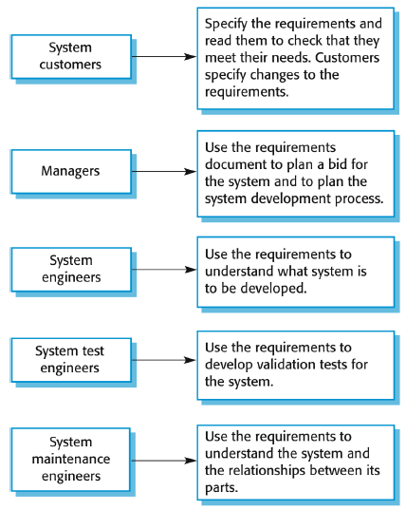
Users of a requirements document

Slide 24
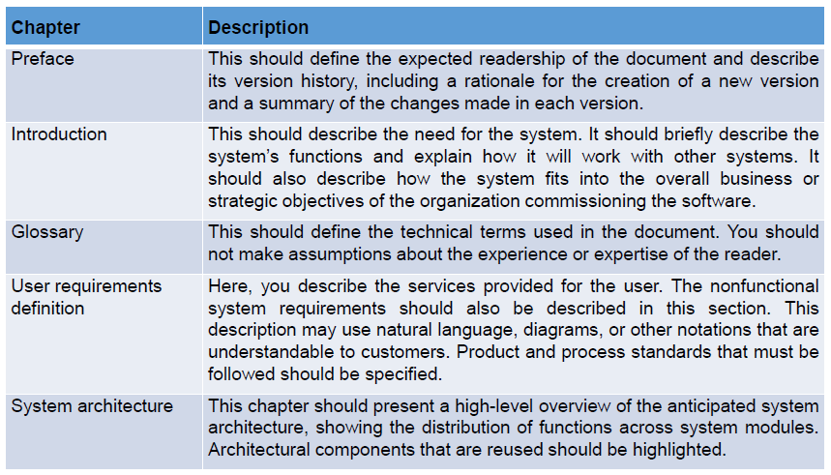
The structure of a requirements document

Slide 25
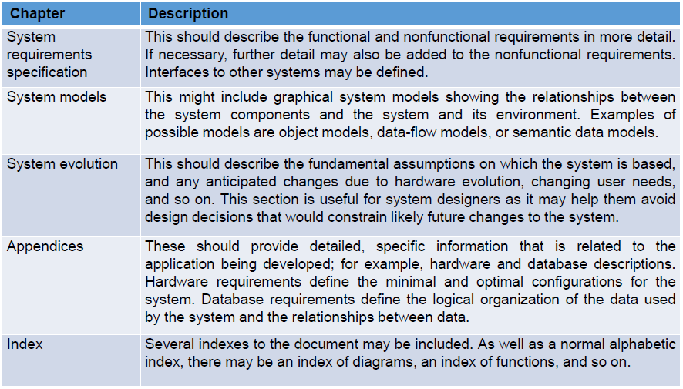
The structure of a requirements document

Slide 26
Requirement's specification
The process of writing down the user and system requirements in a requirements document
User requirements have to be understandable by end users and customers who do not have a technical background
System requirements are more detailed requirements and may include more technical information
The requirements may be part of a contract for the system development
It is therefore important that these are as complete as possible

Slide 27
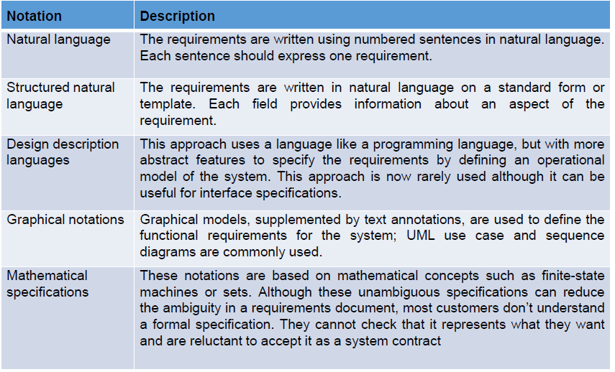
Ways of writing a system requirements specification

Slide 28
Natural language specification
Requirements are written as natural language sentences supplemented by diagrams and tables
Used for writing requirements because it is expressive, intuitive and universal. This means that the requirements can be understood by users and customers.

Slide 29
Guidelines for writing requirements
Create a standard format and use it for all requirements
Use language in a consistent way. Use shall for mandatory requirements, should for desirable requirements.
Use text highlighting to identify key parts of the requirement
Avoid the use of computer jargon
Include an explanation (rationale) of why a requirement is necessary

Slide 30
Problems with natural language
Lack of clarity
▪Precision is difficult without making the document difficult to read.
Requirements confusion
▪Functional and non-functional requirements tend to be mixed-up.
Requirements amalgamation
▪Several different requirements may be expressed together.

Slide 31
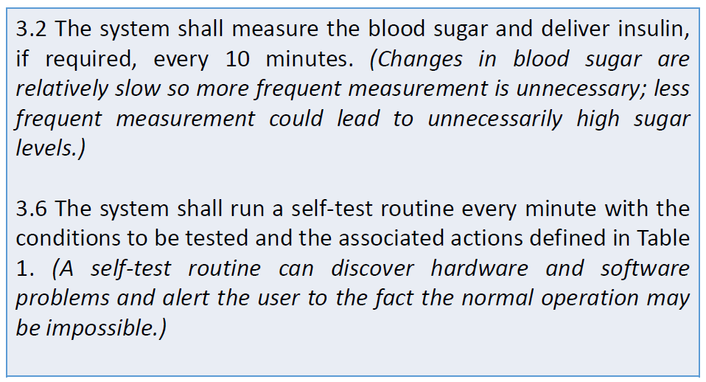
Example requirements for the insulin pump software system

Slide 32
Tabular specification
Used to supplement natural language
Particularly useful when you have to define a number of possible alternative courses of action
For example, the insulin pump systems bases its computations on the rate of change of blood sugar level and the tabular specification explains how to calculate the insulin requirement for different scenarios

Slide 33
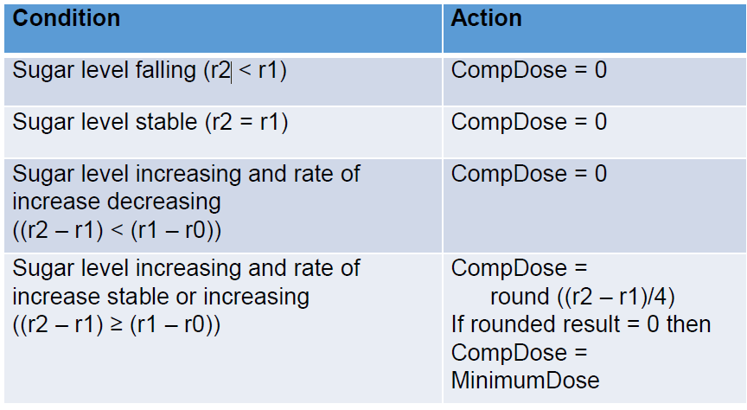
Tabular specification of computation for an insulin pump

Slide 34
Structured specifications
An approach to writing requirements where the freedom of the requirements writer is limited and requirements are written in a standard way
This works well for some types of requirements, e.g. requirements for embedded control system but is sometimes too rigid for writing business system requirements

Slide 35
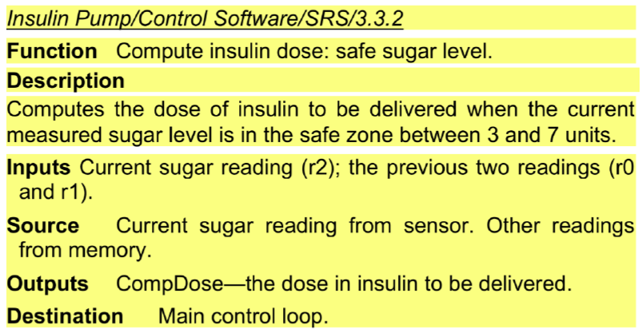
A structured specification of a requirement for an insulin pump

Slide 36
A structured specification of a requirement for an insulin pump

Slide 37
Form based specifications
Definition of the function or entity
Description of inputs and where they come from
Description of outputs and where they go to
Information about the information needed for the computation and other entities used
Description of the action to be taken
Pre and post conditions (if appropriate)
The side effects (if any) of the function

Slide 38

Exercise

Slide 39
Identify Function and Non-Function Requirements
• The software automatically validates customers against the ABC Contact Management System
• FR
• Employees never allowed to update their salary information. Such attempt should be reported to the security administrator.
• NFR

Slide 40
• Users must change the initially assigned login password immediately after the first successful login. Moreover, the initial should never be reused.
• NFR
• The software system should be integrated with banking API
• FR
• Every unsuccessful attempt by a user to access an item of data shall be recorded on an audit trail.
• NFR

Slide 41
• The software should be portable. So moving from one OS to other OS does not create any problem.
• NFR
• The software system should pass Section 508 accessibility requirement.
• NFR

Slide 42
• The background color for all windows in the application will be blue and have a hexadecimal RGB color value of 0x0000FF.
• FR
• A website should be capable enough to handle 20 million users with affecting its performance
• NFR
• The Sales system should allow users to record customers sales
• FR

Slide 43
Parameters | Functional Requirement | Non-Functional Requirement
What it is | Verb | Attributes
End-result | Product feature | Product properties
Capturing | Easy to capture | Hard to capture
Objective | Helps you verify the functionality of the software. | Helps you to verify the performance of the software.
Area of focus | Focus on user requirement | Concentrates on the user's expectation.
Documentation | Describe what the product does | Describes how the product works
Type of Testing | Functional Testing like System, Integration, End to End, API testing, etc. | Non-Functional Testing like Performance, Stress, Usability, Security testing, etc.
Test Execution | Test Execution is done before non-functional testing. | After the functional testing
Product Info | Product Features | Product Properties

Slide 44


